Slide 1
Capability Capsule
A schema every capability declares, so every check has a target
Muk Chunpongtong · Design workshop, 22 September 2026
Notes:
TIME 0:20
SAY: Capability Capsule is a schema: the contract every capability in the new AI4Research system declares, so the tools that build, check, choose and run capabilities can do their job. Everything here is design. Nothing is built yet.

Slide 2
SUMMARY
a to g in one page
Req. | Answer | Slides
a Function | declare, admit, make available. Safer than watching | 3-8
b Architecture | one manifest, two levels, predicate parity, imports | 9-14
c Position | planning, freeze, dispatch, claims, on agent-core | 15-18
d Dependencies | one agreed record per neighbour | 19-20
e Similar designs | others watch, this schema declares and tests | 21
f Advantages | safer, cheaper selection, each falsifiable | 22-25
g Feasibility | every part exists, and ownership is for discussion | 26-27
THUS declare first, so every check has a target
companion.md, SCHEMA.md v1.6
2
Notes:
TIME 0:30
SAY: The whole talk on one slide. One idea runs through all seven answers: declare first, so every check has a target, and check before any run uses a capability.

Slide 3
A · FUNCTION
Capability Capsule is a schema, not a tool
 | What happens | Who
Declare | a capability states its conditions, outputs and effects | its author, in the manifest
Admit | a version is kept only if tests of its declared job pass | the admission rule decides, the verifier measures
Make available | which kept versions a run may bind | the librarian writes it, the run pins it
Compose | add, replace, roll back, remove without breaking others | the capsule layer, from the manifest
Scheme is the supervisor's word for this schema plus the rules the capsule layer applies with it
RSI builds capsules. A run pin records what a run used. The librarian keeps the library
THUS a scheme that uses tools such as the verifier, and is never a tool itself
Supervisor, 2026-09-18 and 2026-09-21
3
Notes:
TIME 0:35
SAY: The supervisor's line: Capability Capsule is a scheme, and the verifier is a tool it uses. The schema defines the rules, and the capsule layer's code applies them on agent-core. Building is RSI's, measuring is the verifier's, choosing models is routing's, running is agent-core's.
IF ASKED:
- Capsules change code, prompts and manifests, never model weights
- AI4Research itself is not a capsule, by the supervisor's ruling

Slide 4
A · FUNCTION
What every capability declares, in one manifest
capability_id: fetch-paper-fulltext revision: 3 capability_type: tool
inputs: paper_id (arxiv_id) outputs: fulltext (document_text)
effects: network read export.arxiv.org write workspace/papers/ (undo: delete the file)
preconditions:
network-allowed run.policy.network includes export.arxiv.org evaluable_at: planning
id-resolves inputs.paper_id resolves in arXiv evaluable_at: dispatch
postconditions:
text-present fulltext has at least one page of text anchor: deterministic
title-matches title matches the arXiv record anchor: reference
dependencies: arXiv API, pinned by endpoint and version load_mode: invoked
components: fetch_fulltext.py sha256 ... lineage: supersedes revision 2
THUS every later slide is about who reads which of these lines
SCHEMA.md A1. Illustrative
4
Notes:
TIME 0:50
SAY: This is the schema, filled in for one AI4Research capability, fetching a paper's full text. It declares what it needs, what it guarantees and what it touches. The filter reads the effects, the types and the first precondition, which can be checked at planning. Dispatch checks both preconditions. The verifier runs the two postconditions. The hash covers the file.
IF ASKED:
- Tests, the certificate and availability are records outside the manifest that name its hash
- The full field list is in SCHEMA.md A1 and the backup slide

Slide 5
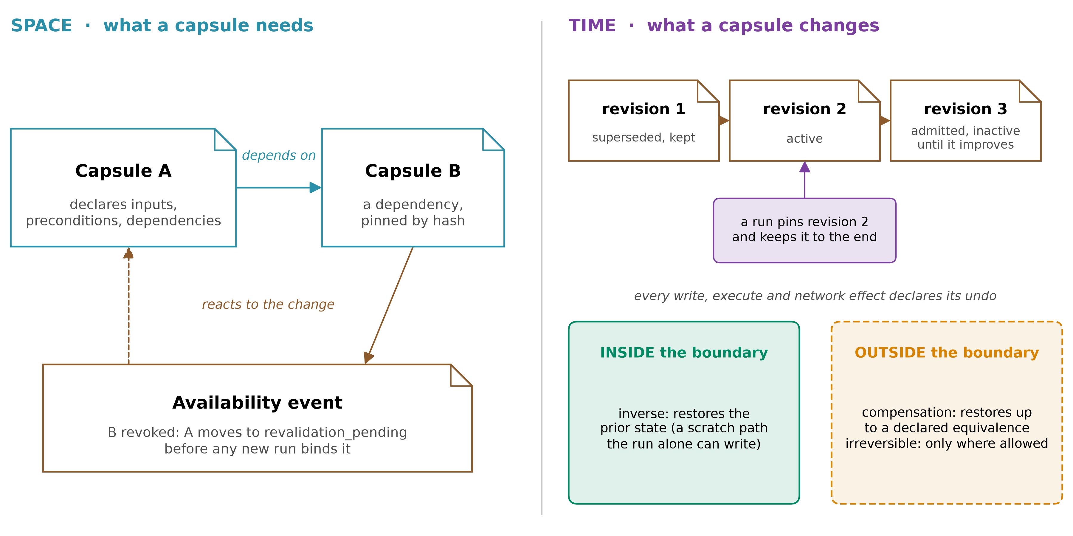
A · FUNCTION
Composable in space and time, by declaration
THUS needs and undo are declared, so the library can change safely around a run
SCHEMA.md Spatiotemporal composability. Cordis (2608.25512), SkillFuzz (2607.02345)
5
Notes:
TIME 0:55
SAY: A library that changes while it is used needs two guarantees. In space, each capsule declares what it needs, so when a dependency is revoked its dependents are revalidated before a new run binds them. In time, each declares how its effects are undone, so versions can be replaced and rolled back. The terms come from Cordis. Reversal only holds inside a boundary, so the schema asks which side each effect is on. And unlike Cordis, composition happens between runs, because a run keeps what it pinned.
IF ASKED:
- Combinations are screened, not certified: the schema supplies SkillFuzz's contracts and records its findings
- SkillFuzz: severe drift 4.7% with one skill loaded, 66.5% with five. 80.6% of high-risk plan flags confirmed in execution
- A step never co-loads a set confirmed as high-risk

Slide 6
A · FUNCTION
Every tool the schema serves is one the research needs
Tool | The failure it answers | Paper
Admission gate | 215 of 222 self-built tools failed every held-out test of their job | Beyond Task Completion
Executability filter | 7.8% of replays picked a skill that could not run | Don't Offer What Can't Be Done
Verifier audit | a lenient judge stopped retirement, and the count hid it | The Blind Curator
Improvement check | without it, 8 points lower. Later cleanup won back 1.7 of 12.3 | When Self-Evolution Backfires
Librarian | harsh retirement fell below the no-skill floor | Library Drift
Composition screening | drift 4.7% with one skill, 66.5% with five. 80.6% of flags confirmed | SkillFuzz
THUS the schema is the set of facts every one of these tools needs
SCHEMA.md. Papers read in full, numbers in verify/PAPER-LEDGER.md
6
Notes:
TIME 0:40
SAY: This is why the schema exists. Each tool the new system needs answers a failure someone measured, and each tool needs the same facts about a capability. The schema is those facts. A field no tool reads is removed.
IF ASKED:
- Libraries are worth having: Alita-G's lifted GAIA pass@1 from 75.15% to 83.03%, on its own build set
- Beyond Task Completion: Haiku 4.5, 3 tool-creating protocols, 3 seeds. Backfires: one run
- Blind Curator: bias injected on a deterministic grader, 3 seeds

Slide 7
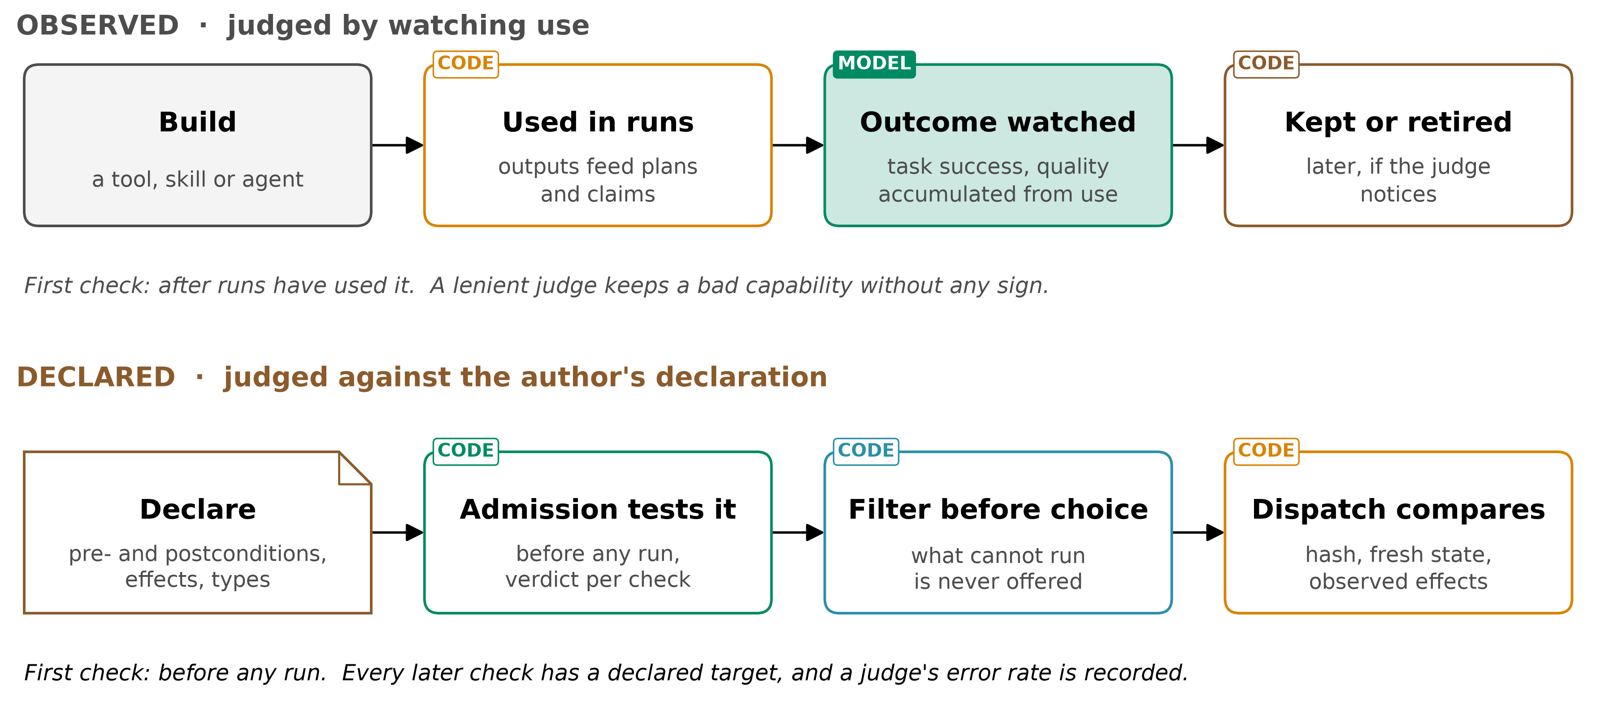
A · FUNCTION
Declaring first is safer than watching afterwards
THUS every later check has a declared target, and the first one runs before any use
companion.md
7
Notes:
TIME 0:45
SAY: Two ways to judge a capability. Watch it in use, and retire it if the judge notices, which means runs have already built on it. Or declare what it needs and guarantees, test that at admission, and check it again before choice and before dispatch. The second gives every check a target, and a guarantee relative to the declaration.
IF ASKED:
- In a frozen plan an unrunnable capsule fails its step at dispatch, and the plan cannot swap it
- Observation keeps a role: held-out tests, retirement and audits all observe against the declaration
- A blocked capsule could not have completed, by construction. Observation only gives a rate, afterwards
- In AI4Research a frozen step cannot swap its capsule, so a wrong output becomes a wrong claim
- A declaration can be false, so admission compares declared and observed effects, and certification tests parity
- Passing a precondition grants no right to any effect

Slide 8
A · FUNCTION
Where declared and observed checking differ
 | Observed | Declared, this schema
First check | after runs used it | before any run uses it
Reference for correct | task success, quality from use | the author's declaration, tested
What cannot run | offered, then fails or is refused | removed by code before any model chooses
A lenient judge | keeps bad capabilities with no sign | its audited error rate is recorded, or its verdict does not count
A wrong output | becomes a claim the frozen plan cannot undo | traced from the claim to the exact binding
THUS the declared column checks first, and leaves a record at every step
companion.md
8
Notes:
TIME 0:40
SAY: Five differences. The first check moves before use. The reference becomes the declaration. What cannot run is never offered. A lenient judge shows up in the record. And a wrong output traces back to the exact capsule that produced it.
IF ASKED:
- Rows one and two: Beyond Task Completion. Row three: Don't Offer What Can't Be Done
- Row four: The Blind Curator. Row five: the run pin

Slide 9
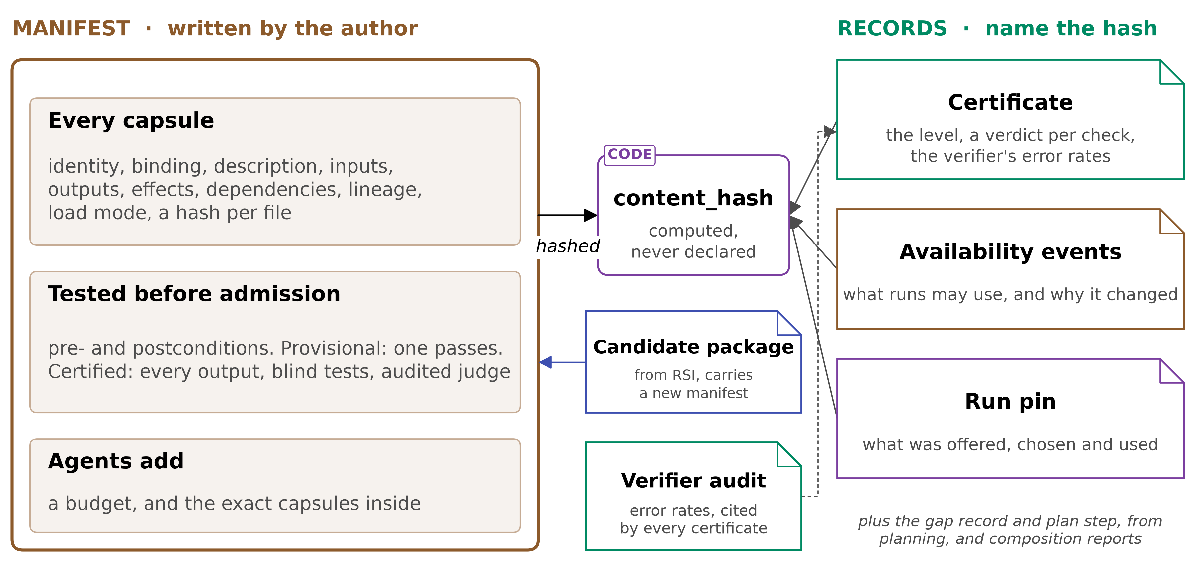
B · ARCHITECTURE
One manifest, one hash, records that name it
SCHEMA.md Part A and B
9
Notes:
TIME 0:40
SAY: The author writes one manifest. Its hash covers every file. Everything else sits outside and names that hash: the certificate, availability events, the verifier audit and the run pin. A record cannot contain its own hash, and retiring a capsule must never change it.
IF ASKED:
- Store, importer, admission rule, provider and librarian are the capsule layer's code

Slide 10
B · ARCHITECTURE
The records around the manifest, and who writes each
Record | Holds | Writer, readers
Certificate | level, a verdict per check, observed effects, parity, verifier error | admission rule, for planner and librarian
Availability event | what runs may use, and a typed reason | librarian, for the planner
Verifier audit | false-pass and false-fail rates | verification, for admission
Run pin | offered, blocked, chosen, hashes, model, exits, tokens, claims | the run, for everyone
Candidate package | manifest, body, tests from another author | RSI, for admission
Gap record | what planning could not bind, counted over runs | planner, for RSI
Plan step | what each node requires, and its typed ports | planner, for the run
Composition report | a co-loaded set, what a screener found, confirmed or not | screening tool, for the planner
THUS eight records, one writer each, and every field has a reader
SCHEMA.md Part A and B
10
Notes:
TIME 0:40
SAY: Eight records sit outside the manifest. Each has one writer and named readers. That is the whole data model, and a field no reader uses is removed.
IF ASKED:
- The run pin is what makes claims traceable and revocation exact

Slide 11
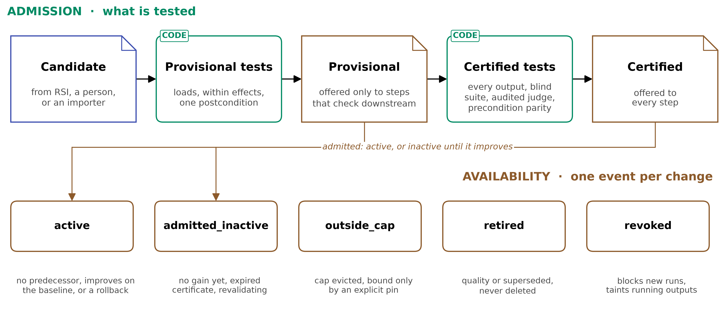
B · ARCHITECTURE
Two levels: every capsule is tested, some are certified
THUS nothing enters untested, and certification decides how far an output may travel
SCHEMA.md A1 to A3
11
Notes:
TIME 0:40
SAY: Nothing enters untested. Provisional means it loads, stays within its declared effects and passes a postcondition, and only steps that check downstream may use it. Certified means every output is tested by someone who never saw the code, with an audited judge. A new revision goes live only if it improves on what it replaces.
IF ASKED:
- Today's AI4Research freeze admits only stable capsules, so provisional admission is new work
- Removing the improvement gate cost 8 points in When Self-Evolution Backfires, one run

Slide 12
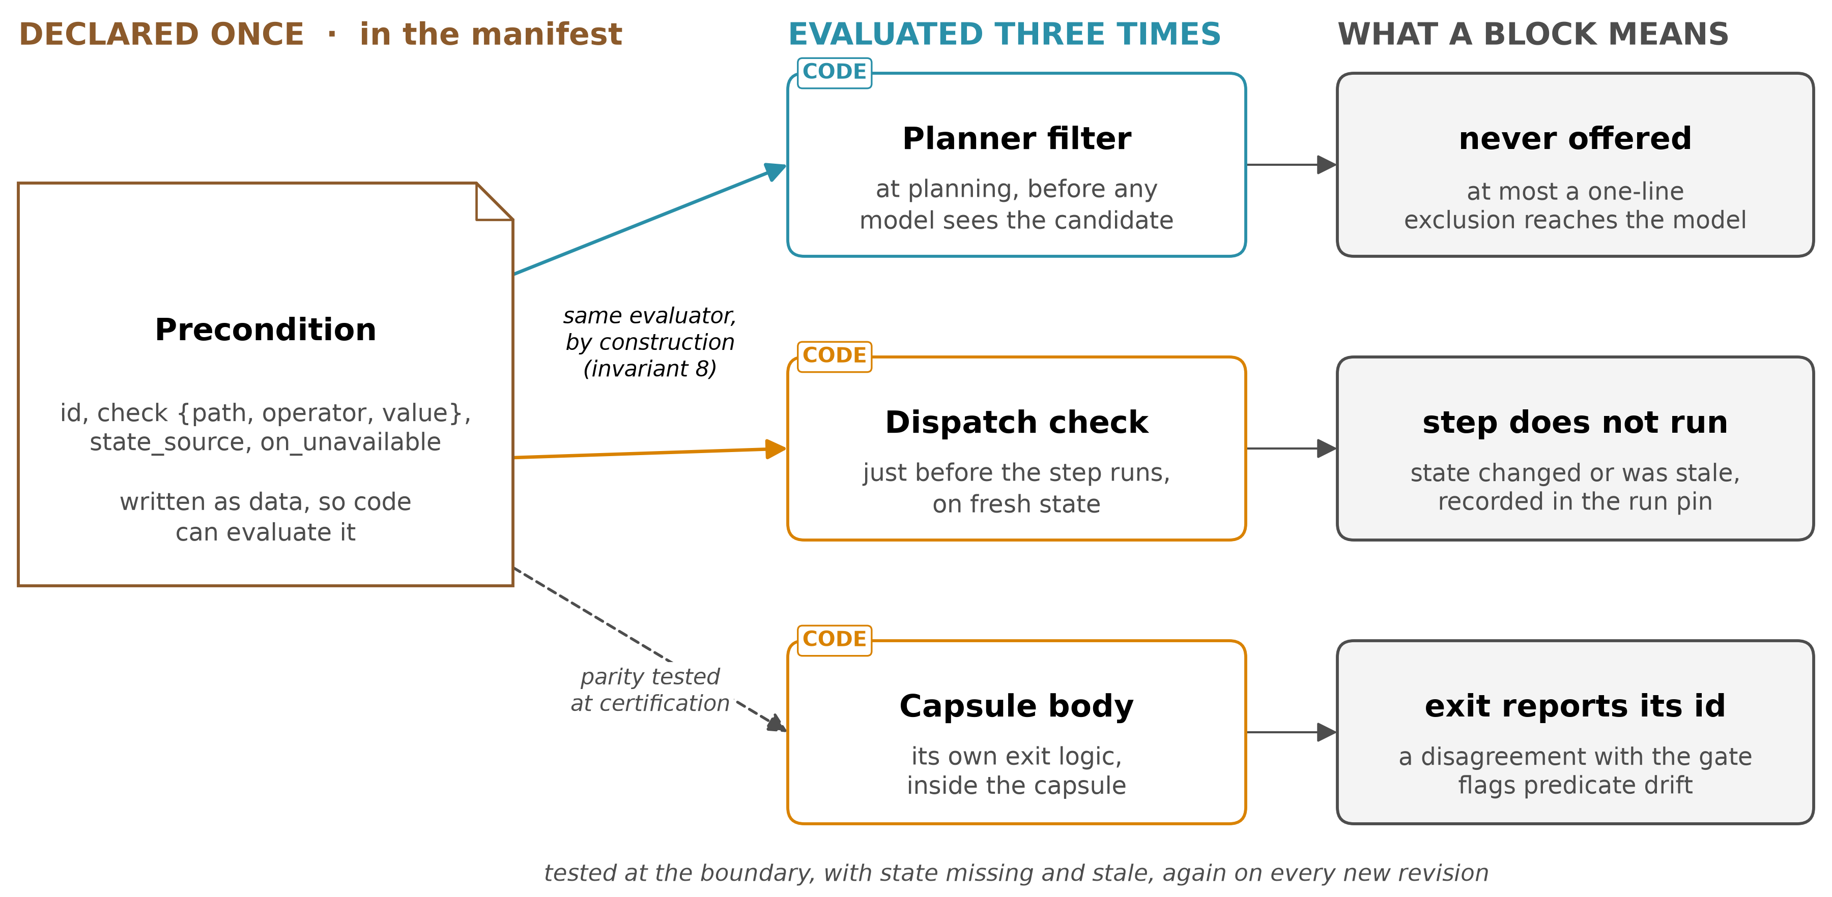
B · ARCHITECTURE
Predicate parity: one predicate, three evaluators
THUS one declared predicate, so the filter and the capsule cannot silently disagree
SCHEMA.md Predicate parity. Don't Offer What Can't Be Done, Contract2Tool
12
Notes:
TIME 0:50
SAY: This comes from Don't Offer What Can't Be Done. The gate evaluates each skill's own exit conditions, so a blocked skill could not have completed. That holds only while the gate and the skill agree, which the authors call predicate parity. Here a precondition is declared once. The filter and dispatch run the same evaluator on it, and certification tests the capsule's own exit logic against it at the boundary, with missing state and with stale state.
IF ASKED:
- Each precondition says when its state is readable: at planning, like a credential, or only at dispatch
- Contract2Tool: a keyword top-5 filter lowered success from 0.775 to 0.620, contract filtering raised it to 0.980
- Today AI4Research's filter never reads preconditions, and dispatch checks four fixed kinds: two predicate sets
- Parity is a release invariant: any change to exit logic is a new revision and repeats the tests
- Contract2Tool: synthetic 100-tool registry, 102 tasks, mocked execution

Slide 13
B · ARCHITECTURE
Parity rules, and the paper's three failure modes
1 A precondition is data over declared state. Intent never is
2 The filter and dispatch run one evaluator over one declaration
3 Only preconditions readable at planning enter the filter, after their parity test
4 Certification tests the body at the boundary, with state missing and stale
5 Any change to exit logic is a new revision and repeats the tests
6 Unreadable state blocks by default, and passing needs a stated reason
7 A body reports which precondition stopped it
8 Passing a precondition grants no right to any effect
THUS each way the filter and the capsule can drift apart leaves a record
SCHEMA.md Predicate parity. Don't Offer What Can't Be Done p3, p5-6
13
Notes:
TIME 0:45
SAY: Eight rules keep parity. A precondition is data, never intent. The filter and dispatch run one evaluator. Only preconditions readable at planning enter the filter, and only after their parity test passes. Certification tests the body at the boundary, with missing and with stale state. Any change is a new revision that repeats the tests. The unavailable-state policy is explicit, block by default. A body reports which precondition stopped it. And passing a precondition grants no right to any effect. Each failure mode the paper names then leaves a record.
IF ASKED:
- Predicate drift shows as an exit on a precondition dispatch passed, then revalidation
- State staleness shows as the filter passing and dispatch blocking. Backend drift as a violated contract

Slide 14
B · ARCHITECTURE
Existing tools, skills, MCP and A2A enter as provisional
Source | Derived automatically | Written to certify
agent-core ToolCard | name, description, inputs, its flags | outputs, postconditions
MCP server | each tool's name, description, schemas, effect proposals | postconditions
SKILL.md skill | name, description, a hash per file | inputs, outputs, postconditions
A2A agent | name, description, version, input and output modes | typed inputs and outputs, postconditions
Old AI4Research capsule | contract, effects, postconditions | tests from an author who never saw the code
THUS an import is usable the day it arrives, and certified when its tests are written
SCHEMA.md A6
14
Notes:
TIME 0:35
SAY: Nothing is rewritten to enter. An importer fills what it can derive and invents nothing. A person confirms the effects and writes one postcondition, and the capsule enters as provisional. Certification is where the real test work is.
IF ASKED:
- Inferred effects are the weak part of an imported contract, so a person confirms them
- A remote MCP server or A2A agent is pinned by endpoint and version

Slide 15
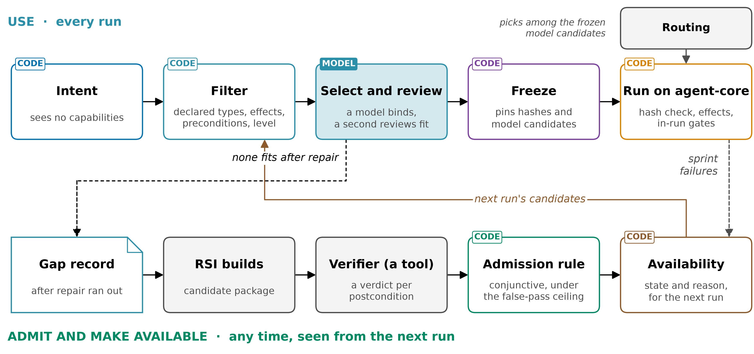
C · POSITION
Where the schema is read in an AI4Research run
SCHEMA.md B4, B6. AI4Research workflow
15
Notes:
TIME 0:40
SAY: The top row is a sprint: the filter on declared fields, a model binds each step and a second reviews the fit, the freeze pins exact hashes, and agent-core runs them while in-run gates judge the outputs. The bottom row runs any time: a gap after repair goes to RSI, the verifier checks the build, and admission changes only the next run.
IF ASKED:
- At dispatch each live hash must equal its pin, which is new
- Each claim records the binding that produced it, so revocation taints exactly its claims

Slide 16
C · POSITION
Plan steps and dependencies, today and in the schema
 | Today, AI4Research and Symphony | In the schema
Step inputs | typed, but unknown matches any same-named input | exact types from one vocabulary
Edges between steps | step ids, or edges a model proposes at 0.7 | declared ports, output to input
Preconditions | four kinds at dispatch, never in the filter | one predicate, filter and dispatch
Change to a capsule | rejected at the freeze, then frozen copies run | kept, plus a hash check at dispatch
Unmet requirement | bounded re-planning, or needs input | typed outcomes, and a gap record for RSI
THUS it keeps what works today, and replaces inference with declaration
SCHEMA.md B6. AI4Research and Symphony read in source
16
Notes:
TIME 0:35
SAY: Both systems already give plan nodes requirements, so the schema keeps what they do and replaces inference with declaration: ports instead of guessed edges, one declared predicate at planning and dispatch, and a pin for every dependency.
IF ASKED:
- AI4Research pins guard capsules at the freeze, but resolves MCP providers live
- A failed step still blocks its descendants, which reopen on recovery

Slide 17
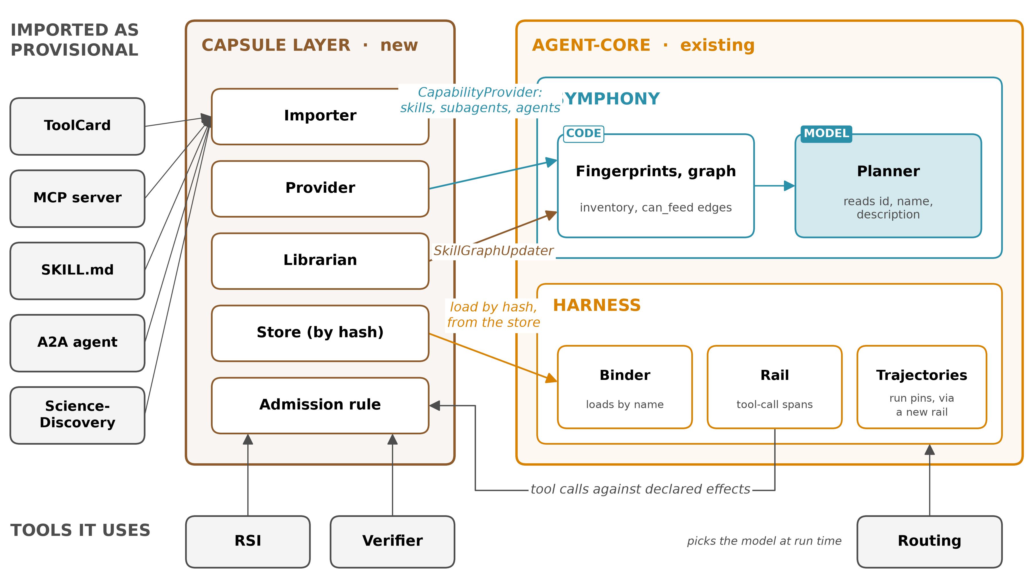
C · POSITION
How the schema plugs into agent-core and Symphony
THUS it plugs into interfaces that exist, and the capsule layer is the new code
agent-core e23806c1 with Symphony, read in source
17
Notes:
TIME 0:45
SAY: The capsule layer is new and sits beside Symphony on agent-core. Its provider feeds Symphony's fingerprints and graph through CapabilityProvider, for skills, subagents and agents. Each availability change calls SkillGraphUpdater. The capsule layer checks the hash and agent-core's binder loads from the store, its rail gives tool-call spans for declared effects, and a new rail saves the run pins. Each hook exists today, and the next slide lists what each still needs.
IF ASKED:
- Symphony's graph takes only skills, subagents and agents. Tool, MCP and A2A capsules go through the filter and binder
- AI4Research binds typed steps, so the filter runs per step. Symphony plans in one call, so it filters per query
- Declared ports replace edges a model proposes at 0.7 confidence
- Effect-level observation is the one likely agent-core change

Slide 18
C · POSITION
The hooks exist, and what each still needs
Schema part | Existing hook | Gap the capsule layer fills
What planning may see | CapabilityProvider, atomic | the graph takes only skills, subagents, agents
Availability changes | SkillGraphUpdater | one revision per id, and each change calls a model
Manifest model | CapabilityIO, ToolCard | a manifest reusing CapabilityIO
Loading | apply_extension_hot | no hash check, so load from the immutable store
Observed effects | before_tool_call rail | a tool capsule's internals stay invisible
Run pin | LoadRecord, TrajectoryStore | records live in memory, so a new rail saves pins
Unmet input | needs_input | kept, beside the typed unmet outcomes
THUS the interfaces exist, and the capsule layer's own code fills each gap
agent-core e23806c1, read in source
18
Notes:
TIME 0:45
SAY: Every connection starts from an interface agent-core already has, and each has a gap I checked in source. The graph only takes skills, subagents and agents. It keeps one revision per id and calls a model on every change. The binder has no hash check, so loading goes through the immutable store. Load records live in memory, so a new rail saves the run pin.
IF ASKED:
- File and line for each hook are in the companion's hooks table and asks/symphony-agent-core.md

Slide 19
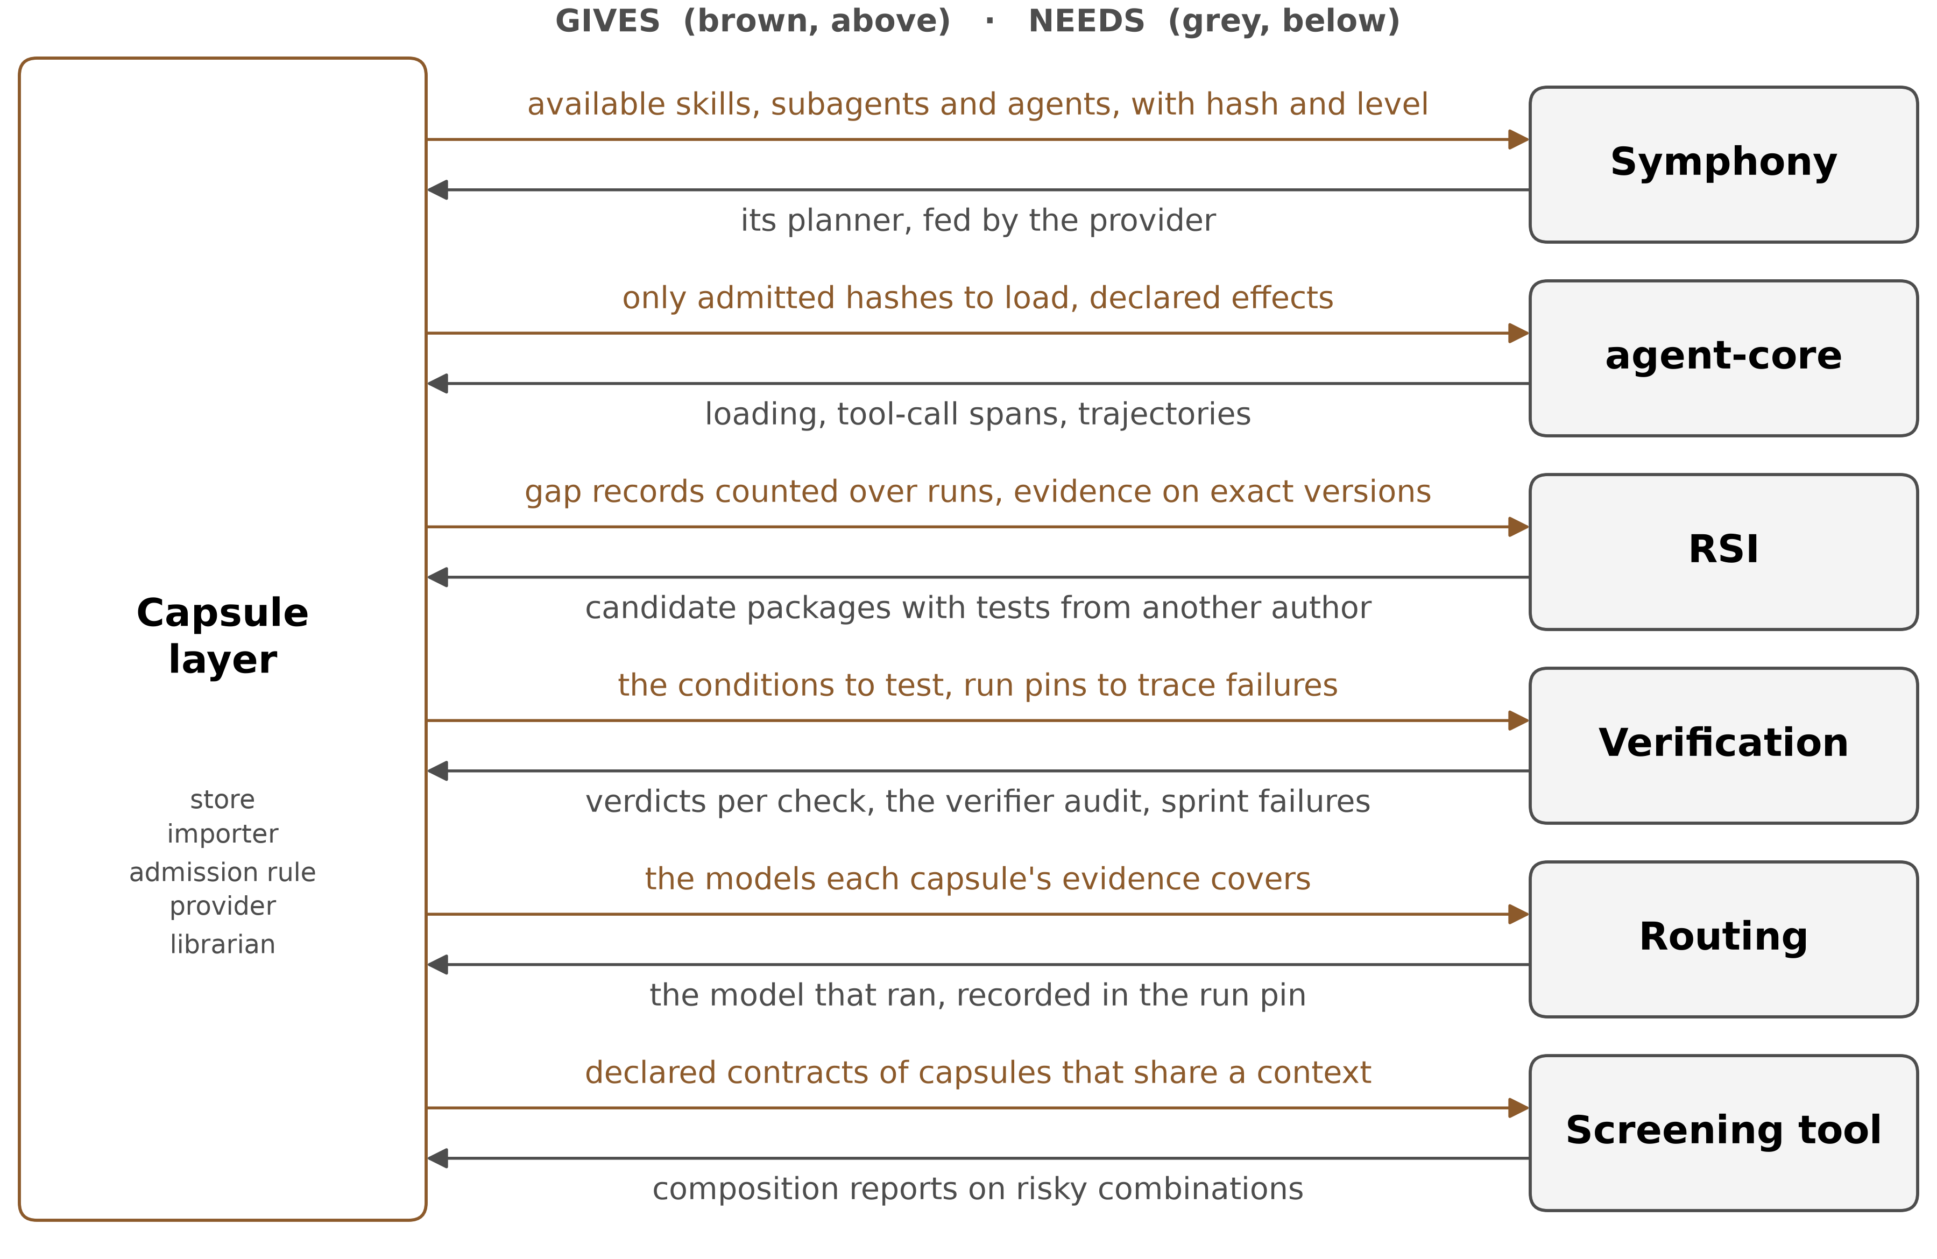
D · DEPENDENCIES
What the schema needs from the system and each teammate
THUS each dependency is a record both sides agree on
SCHEMA.md Part B, asks/
19
Notes:
TIME 0:35
SAY: Each dependency is a record both sides agree on, and none says how the other side works. Verification works at three levels: the capability at admission, the system at each sprint, and the verifier itself through its audit.
IF ASKED:
- RSI and verification have four months, so their two formats are settled first
- skillhub, ScienceDiscovery and jiuwenswarm are import sources and patterns, and need no change

Slide 20
D · DEPENDENCIES
If a dependency is not there yet
Missing | What happens meanwhile
Candidate packages from RSI | capsules come only from the importer, as provisional
A verifier audit | judged verdicts are advisory, only deterministic and reference checks count
Effect-level observation | code-heavy capsules stay provisional, tool-only capsules can certify
A model outside the candidates | only steps accepting provisional capsules may run it, then revalidation
A vocabulary owner | the capsule layer seeds it from Symphony's
THUS each gap lowers what is certified, never what is checked
SCHEMA.md A2, A4, B4
20
Notes:
TIME 0:35
SAY: Each missing piece lowers what can be certified, never what is checked. So the first milestone needs nothing outside this team.

Slide 21
E · SIMILAR DESIGNS
Others watch a capability, this schema declares it
System | Reference for correct | Kind
Alita-G, Darwin Godel Machine | the task outcome | observed
Symphony's fingerprint | quality gathered from use | observed
Skill Drift, Contract2Tool | contracts inferred from documents and traces | inferred
skillhub, ScienceDiscovery | a person or a policy | reviewed
Don't Offer What Can't Be Done | each skill's own exit conditions | declared, selection only
MCP, SKILL.md, A2A cards | a name and a schema, unchecked | declared, unchecked
GraSP, Agent Behavioral Contracts | preconditions and effects, checked in the run | declared, not tied to admission
This schema | the author's declaration, tested before use | declared and tested
THUS declared contracts exist, but none is tied to admission and selection
Papers read in full. openJiuwen read in source. Public specifications
21
Notes:
TIME 0:35
SAY: Every system checks something. The difference is where the reference for correct comes from. Here it is the author's declaration, tested before anything is kept and used again at selection and dispatch.
IF ASKED:
- RelAIBuild checks file scope after an edit lands, detection rather than prevention
- Lockfiles and Sigstore prove who built something, not what it does

Slide 22
F · ADVANTAGES
Five advantages, each with what would prove it wrong
Advantage | Proved wrong if
safer selection: what cannot run is never offered | a capsule passes the filter, then exits on that precondition, or a false block
fewer tokens at selection | no drop in selection tokens against today's filter, at equal success
a kept capability's own job is tested | a certified capsule fails a held-out test of its declared job
a lenient verifier becomes visible | retirements stop while evictions continue, and no audit follows
claims trace to exact capsules, imports need no rewrite | a claim has no binding and hash, or an import needs code changes
THUS each advantage names the result that would disprove it
SCHEMA.md, PAPER-LEDGER.md
22
Notes:
TIME 0:35
SAY: Each advantage comes with what would disprove it, so the room can hold the design to it.
IF ASKED:
- Not claimed: fixing degradation at scale, identical replays, safe combinations, or task success
- Much of the degradation at scale is agents using no skill at all, which a filter cannot fix

Slide 23
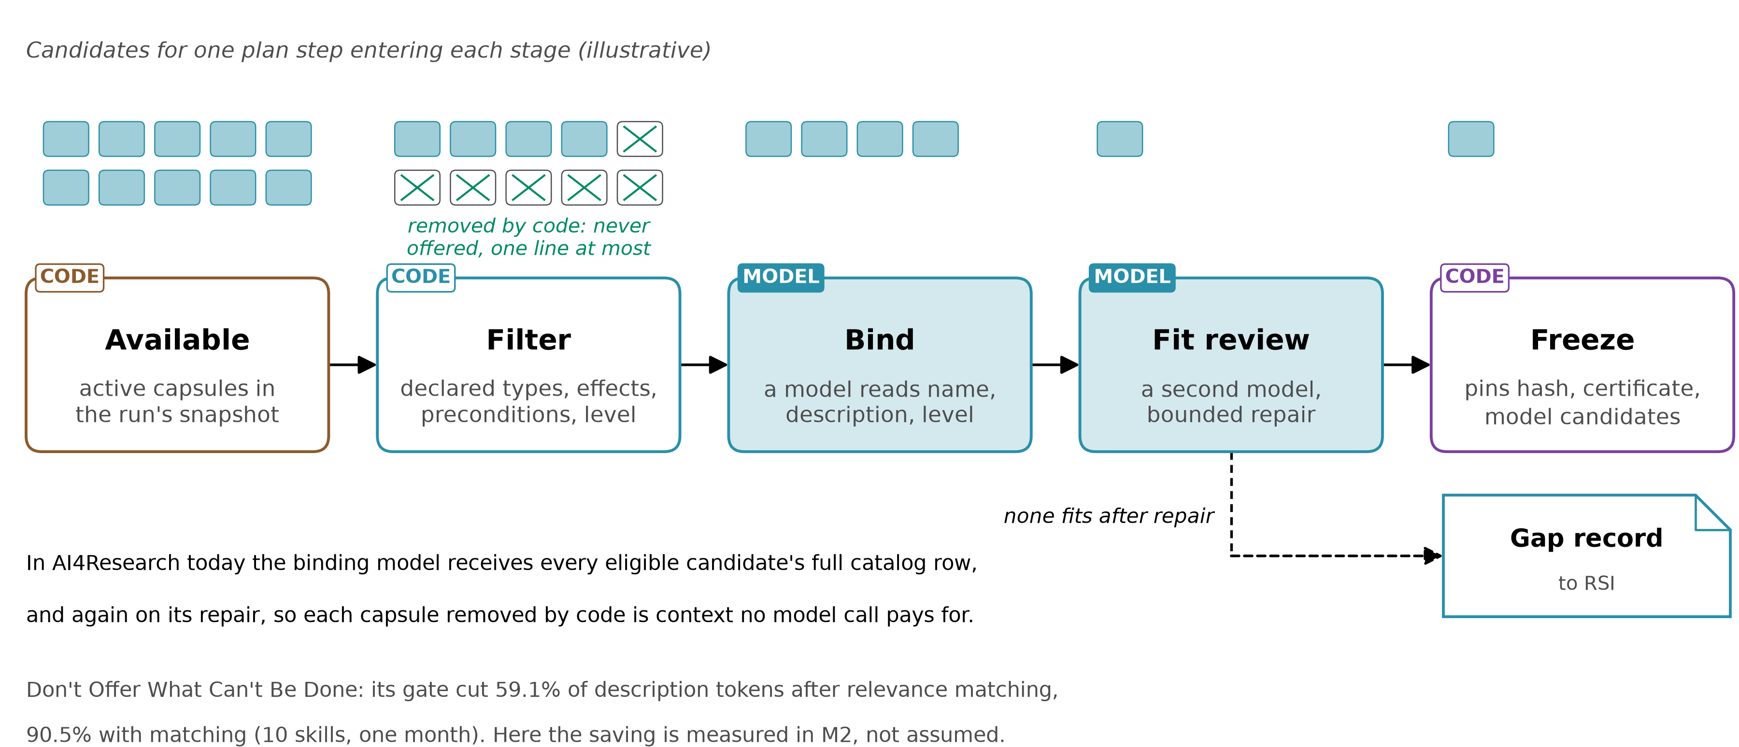
F · ADVANTAGES
Code removes what cannot run before a model chooses
THUS safer and cheaper: never offered, and one line instead of a full row
Don't Offer What Can't Be Done. Contract2Tool. AI4Research planner read in source
23
Notes:
TIME 0:45
SAY: Every capsule the filter removes is one no model can pick. That is safer, because the model cannot pick what cannot run, and cheaper, because its full description shrinks to one line. In AI4Research the binding model receives every eligible candidate's full catalog row, and again on repair, so the saving carries over. How much is measured in M2, not assumed.
IF ASKED:
- Don't Offer: 59.1% fewer description tokens after matching, 90.5% combined. Not billed cost or latency
- Contract2Tool: 26,172 to 2,528 tokens a task, success 0.775 to 0.980
- More Skills, Worse Agents: pass rate 0.49 with the right skills alone, 0.28 at 202 skills

Slide 24
F · ADVANTAGES
Tokens: what the papers measured, and what carries over
Source | Measured | Carries over because
Don't Offer What Can't Be Done | 59.1% fewer description tokens after matching, 90.5% combined | a removed capsule is never offered
Contract2Tool | 26,172 to 2,528 tokens a task, success 0.775 to 0.980 | the filter reads declared contracts
AI4Research today | full rows for eligible capsules, short exclusion rows for the rest | a precondition turns a full row into a short one
Symphony today | the planner reads names and descriptions, checks I/O after the plan | the filter moves checks before it
THUS the mechanism carries over, and M2 measures the size here
Don't Offer What Can't Be Done, Contract2Tool, SkillFuzz. AI4Research and Symphony read in source
24
Notes:
TIME 0:45
SAY: The papers measured the size of the effect. AI4Research's planner shows the mechanism applies, because the binding model reads every eligible capsule's full catalog row, and again on repair. I do not claim a number for AI4Research. The run pin records what was offered and blocked and the selection tokens, so M2 measures it against today's filter.
IF ASKED:
- Baseline is today's filter, which already removes on types and effects. 46 capsules today, so the share grows with the library
- M2 reports false blocks and task success beside tokens, since over-blocking also lowers tokens
- Don't Offer: ten skills, one month, description tokens, not billed cost or latency
- Contract2Tool: synthetic registry and mocked execution. A keyword filter lowered success to 0.620

Slide 25
F · ADVANTAGES
What the schema does not claim
Fixing degradation at scale: much of it is agents using no skill, which a filter cannot fix
Identical replays: a model behind an API changes, so runs are recoverable, not identical
Safe combinations: drift rose from 4.7% to 66.5% of plans, so combinations are screened, not certified
Task success: passing the filter means no declared exit holds, not that the capsule succeeds
THUS held to what it offers, and no more
companion.md, PAPER-LEDGER.md
25
Notes:
TIME 0:30
SAY: Four limits, so the design is held to what it offers and no more. Each gate judges one capsule at a time, and composition risk is real.

Slide 26
G · FEASIBILITY
Every part exists somewhere, the work is combining them
Part | In openJiuwen or AI4Research | Built in a paper
Store, pinning, loading | ScienceDiscovery store, agent-core binder | Execution lineage
Filter, binding, fit review | AI4Research's planner | Don't Offer What Can't Be Done
Held-out tests, separate verifier | program_opt, skillhub review | Beyond Task Completion, CoEvoSkills
Verifier audit, typed verdicts | not yet | The Blind Curator, Cognitive Admission Control
Retirement under a cap, drift | not yet | Library Drift, Skill Drift
THUS who owns each part is for the room to decide, since the capsule touches every team
SCHEMA.md. Each paper read in full
26
Notes:
TIME 0:45
SAY: Each part has been built somewhere and no one has combined them. The schema is easy to write and hard to prove, so the risk is the combination. M1 is the store, importer and provisional admission. M2 puts declared predicates in the filter and measures blocked picks and selection tokens. The test is a four-arm comparison on AI4Research tasks.
IF ASKED:
- Risks: effects seen only at tool-call level, provisional admission changes the freeze, ports change Symphony's graph
- Cost: more work per capability, some latency, some rejections a person would accept
- Prediction: fewer kept capsules fail their own job, fewer unrunnable ones are offered, fewer selection tokens

Slide 27
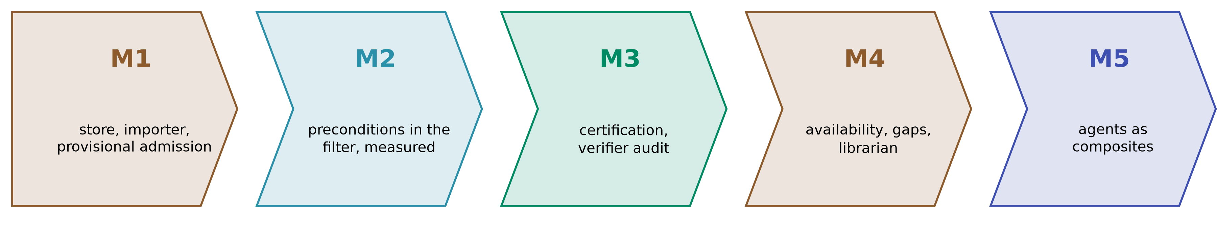
G · FEASIBILITY
Five milestones, provisional first
 | Needs | Measured by
M1 store, importer, provisional admission | nothing outside this team | imports admitted, run pins complete
M2 declared filter, after parity tests | M1 | blocked picks, false blocks, tokens, success
M3 certification, verifier audit | a verdict format, a sandbox | held-out failures of certified capsules
M4 availability, librarian | the candidate package format | retirements by reason
M5 agents as composites | M4 | composites admitted with pinned children
THUS an order to discuss, not a division of work yet
SCHEMA.md, companion.md
27
Notes:
TIME 0:40
SAY: Each milestone is usable on its own. M1 needs nothing outside this team. M2 is where the token and safety claims get measured. M5, agents as composites, comes last.
IF ASKED:
- M5: agents as composites, first a gate, after M4

Slide 28
WORKSHOP
Questions for the room, each with a default
Question | Default
Who owns the model that binds capsules? | Symphony's planner, fed by the provider, filter first
Fail open or closed when state is unreadable? | closed, stated per precondition
What false-pass ceiling counts toward certification? | 0.05 until measured
Who owns the observing sandbox? | the capsule layer, on agent-core's tool-call hooks
What does a sprint-level failure send? | the run and step, traced through the run pin
What counts as a different author for tests? | a separate session with no access to the code
THUS each answer changes a record, not the idea
SCHEMA.md, asks/
28
Notes:
TIME 0:35
SAY: These are the decisions that belong with other components. Each has a default, so none of them blocks the first milestone.
IF ASKED:
- Also open: the type vocabulary, how model candidates are expressed, the librarian, Ground Truth

Slide 29
BACKUP
Eight invariants hold whatever the specification becomes
1 The contract is the only interface
2 The library is append-only. A better version is a new revision
3 A run sees only the versions it started with
4 Whatever decides never builds, and nothing may change the gate or the verifier
5 A capsule is certified only on tests from an author who never saw its code
6 Every write, execute and network effect says how it is undone, or that it cannot be
7 Admission has a threshold, and this team owns it
8 Eligibility is decided only by declared predicates, through one evaluator
SCHEMA.md
28a
Notes:
INSERT: optional slide; delete or hide it and the talk flows unchanged
TIME 0:20
SAY: Shown only if asked.

Slide 30
BACKUP
Every manifest field, and its reason
Field | Why
identity, revision, version | a stable id, and a new revision for every change
description, binding | what the binding model reads, and how agent-core loads it
inputs, outputs, effects | exact types, and every effect with how it is undone
preconditions, postconditions | one declared predicate, and tests of the capsule's own job
dependencies, components | every dependency pinned, a hash per file
load_mode, lineage | loaded into context or invoked, and what it replaces
budget, children | for agents: limits between calls, and the exact capsules inside
SCHEMA.md A1
28b
Notes:
INSERT: optional slide; delete or hide it and the talk flows unchanged
TIME 0:20
SAY: Shown only if asked.

Slide 31
BACKUP
Strict by default, flexible by declaration
Dependency declared as | What follows
no role | pinned by hash, model version, service version or capsule hash
floating, with a role and contracts | may move. The capsule stays provisional, and each contract is checked
contract violated | a repair request naming the broken assumption
SCHEMA.md A5, after v1
28c
Notes:
INSERT: optional slide; delete or hide it and the talk flows unchanged
TIME 0:20
SAY: Shown only if asked.

Slide 32
BACKUP
What the schema gives the librarian
Job | What the schema gives
Admit | a verdict per check, and what a deferral is waiting for
Keep the active set small | revisions activate only on improvement, evictions record the value lost
Retire | trials, threshold and contribution, tied to the verifier's audit
Watch the verifier | quality retirements against cap evictions trigger an audit
Watch parity | block rates per precondition, gate against exit disagreements
Revoke, re-check, fill gaps | exact taint down to claims, certificate expiry, unanswered gaps
SCHEMA.md B5
28d
Notes:
INSERT: optional slide; delete or hide it and the talk flows unchanged
TIME 0:20
SAY: Shown only if asked.

Slide 33
BACKUP
agent-core fully provides one of five needed properties
 | Needed | What agent-core has
H1 | reversible registration | yes: hot apply and unapply, undone in reverse order
H2 | dependency tracking | no. The capsule layer closes capsule dependencies at bind
H3 | immutable versioned artifacts | for graph artifacts only
H4 | a reconstructable execution log | an append-only trajectory archive, once wired
H5 | a record of what ran | tool calls only, not what code does inside
agent-core e23806c1, read in source
28e
Notes:
INSERT: optional slide; delete or hide it and the talk flows unchanged
TIME 0:20
SAY: Shown only if asked.

Slide 34
BACKUP
openJiuwen schemas each hold part of this one
Schema | Has | Lacks
agent-core ToolCard | identity, inputs, exposure, parallel-safe, stateless, idempotent | outputs, postconditions, hashes, versions
Symphony descriptor | typed inputs and outputs, content hash, available | preconditions, effects, admission
skillhub review | a review per version, a policy version, a zip hash | a contract. A version can be force-overwritten
ScienceDiscovery library | per-file hashes, revisions, skills pinned per run | postconditions, effects, an audited verifier
Read in source, 2026-09-21
28f
Notes:
INSERT: optional slide; delete or hide it and the talk flows unchanged
TIME 0:20
SAY: Shown only if asked.

Slide 35
BACKUP
Admission checks, each run by a tool
Check | Level
Manifest valid, file hashes match, binding loads | both
Smoke run within declared effects, at tool-call level | both
At least one postcondition passes on new inputs | provisional
Every output covered, tests from an author who never saw the code | certified
Precondition parity: boundary, missing and stale state | certified
Model judgment | counts only under the false-pass ceiling
An unknown verdict | defers with a typed evidence request
SCHEMA.md A1, A2
28g
Notes:
INSERT: optional slide; delete or hide it and the talk flows unchanged
TIME 0:20
SAY: Shown only if asked.

Slide 36
BACKUP
The supervisor's components, mapped onto the schema
Supervisor's component | Where it lives here
Rules, Boundary, Interfaces | preconditions, effects, typed inputs and outputs
Skills | the body
Governance | lineage, certificates, availability events
Eval | the certificate references the tests, and the gate stays outside
Assets, Data | declared as dependencies, not carried inside
Ground Truth | proposed: reference answers pinned as data, curated by verification
Supervisor's slides, 2026-09-18
28h
Notes:
INSERT: optional slide; delete or hide it and the talk flows unchanged
TIME 0:20
SAY: Shown only if asked.

Slide 37
BACKUP
Risks, each with its answer
Risk | Answer
Effects seen only at tool-call level | code-heavy capsules stay provisional until a sandbox observes effects
Provisional admission changes the freeze | provisional capsules bind only to steps that accept them
Declared ports change Symphony's graph | ports sit beside proposed edges until M2 shows no loss
Parity needs exits to report their id | until tested, a precondition is checked at dispatch only
Declarations gamed or under-declared | another author's suite, reasons for empty lists, observed effects
Over-blocking starves steps | M2 reports false blocks and task success beside tokens
THUS each risk has a contained answer
companion.md
28i
Notes:
INSERT: optional slide; delete or hide it and the talk flows unchanged
TIME 0:35
SAY: Six risks, each contained by a design answer. The cost is more work per capability, some latency, and some rejections a person would accept.

Slide 38
BACKUP
The test that decides whether the combination works
Arm | Library | Prediction
1 | no library | the baseline
2 | built without admission | more kept capsules fail their job, more unrunnable ones offered
3 | curated by observation, a judge retires by outcome | the comparison the design must beat
4 | the same library under this schema | fewer failures and unrunnable offers, success no lower than 3
THUS only a comparison on AI4Research's own tasks proves the combination
companion.md
28j
Notes:
INSERT: optional slide; delete or hide it and the talk flows unchanged
TIME 0:35
SAY: Each paper shows a part works in its own setting, not that the whole works here. Only this comparison on AI4Research's own tasks, with the same models and budget, can show that.
IF ASKED:
- Ground Truth reference answers curated by verification, pinned as data
- An ablation with the filter alone separates what admission adds from what the filter adds

